Slide 1
Programming for graphics
Input and Movement

Slide 2
This is a catch up session
You had a lot to do last week and I’m expecting that most of you have not finished the work from the previous session. This is you chance.

Slide 3
input
Why do we need input?
Well our games won’t be much fun if we can’t interact with them.
Input comes in many forms.

Slide 4
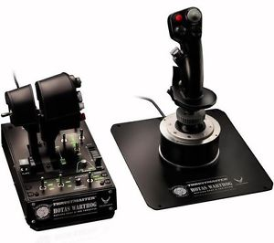
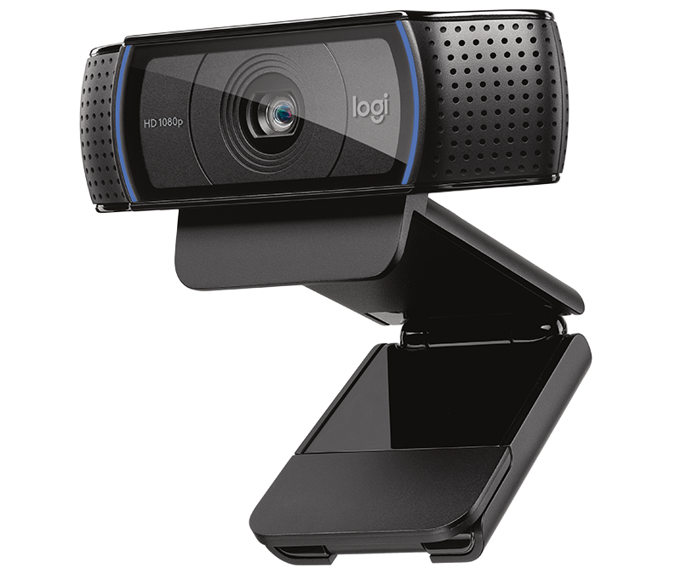
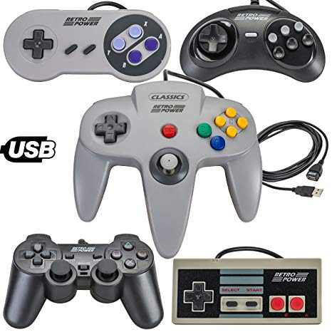
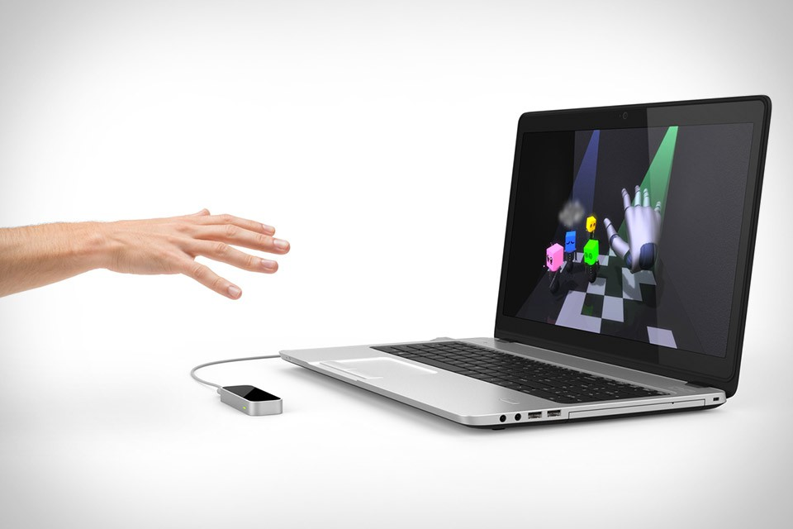

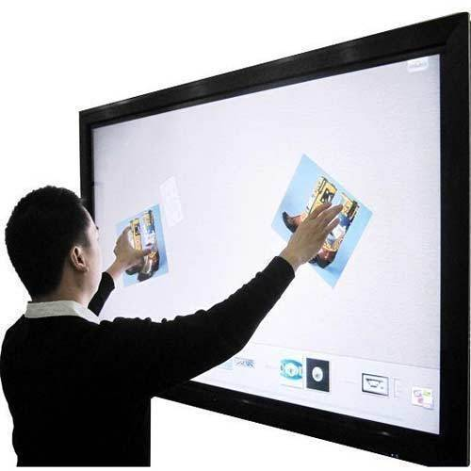


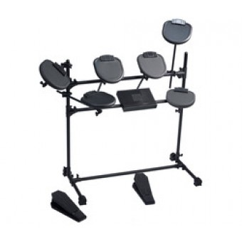

Slide 5

Notes:
But for now we’re just interested in these

Slide 6
How do we get input from the keyboard
At the lowest level, your keyboard sends an event to your computer saying “Iv been pressed” and which key was pressed.
This event is propagated to windows and then on to the application that has focus (IE our game)
All we need to do is query what events have been raised and process them when needed
SDL can help us with this.
SDL collects these events in one place and we just need to ask politely.

Slide 7
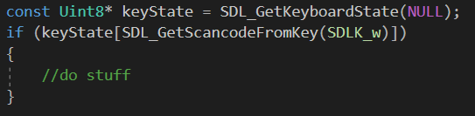
Getting key presses from SDL
This code gets the current state of the keyboard.
Using that state it checks to see if the scan code of the w key is true (i.e. pressed).
If it is, we do stuff!
The NULL parameter is used to get the number of keys pressed.

Slide 8

Polling
You will have to ask SDL, regularly, what the current state of the keyboard is
This is called Polling
And its inefficient
Event queues are better
Look in to them

Slide 9
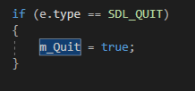


Other events
Could be used to exit our main loop and close our program
We can look for more than just key presses too.
See
https://wiki.libsdl.org/SDL_Event
Could be used to move a camera based on mouse movement or zoom based on scrolling.
Gets the current mouse state
Gets the mouse scroll wheel state.

Slide 10
Window events
SDL_WINDOWEVENT
SDL_WINDOWEVENT_SIZE_CHANGED
SDL_WINDOWEVENT_SHOWN
SDL_WINDOWEVENT_HIDDEN
SDL_WINDOWEVENT_EXPOSED
SDL_WINDOWEVENT_RESIZED
SDL_WINDOWEVENT_MINIMIZED
SDL_WINDOWEVENT_MAXIMIZED
SDL_WINDOWEVENT_RESTORED
SDL_WINDOWEVENT_ENTER
SDL_WINDOWEVENT_LEAVE
And more!!!!
See: https://wiki.libsdl.org/SDL_WindowEvent

Slide 11
Questions?

Slide 12
This lesson
Finish what you started last lesson
Use SDL to get keyboard input
Used the input to move the camera around
Used the mouse to alter where the camera is looking
Hint: you may have to alter the target.

